Slide 1
Biodiversity in National Parks
A Codecademy Portfolio Project
Veronika Konczné Guld, 2023. április

Slide 2
The Data
Data Science Career Path from Codecademy
Porfolio Project: Data Science Foundations II.
Data: from Codecademy, not real but from reallity inspired
2 databases: species and observations

Slide 3
Species and Observations
more detail in Appendix
Species | Observations
5824 records in 4 columns | 23296 records in 3 columns
category, scientific_name, common_names, conservation_status | scientific_name, park_name, observations

Slide 4
Questions
Main question:
Are there any patterns or themes to the types of species that become endangered? (from Codecademy Task Description)
2 area to investigate
I. relation of category and endangered status
Are there any categories which have bigger probability to be in danger?
II. relation of endangered status and park name
Are there national parks where more endangered species are observed than at other places?

Slide 5
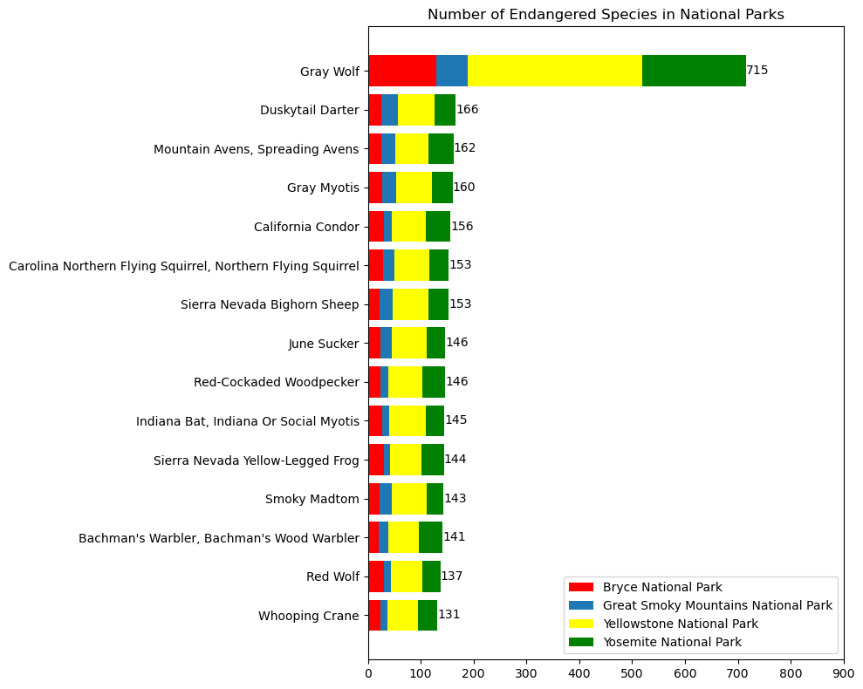
Results
Research | Result
Most representative conservation status | Not in danger, species of concern
Most representative category | All data: vascular plants In danger: birds, vascular plants, mammal
Percent of species in danger | Mammal (17.51), birds (15.36) – vascular plants (1.07)
Relation between category and being in danger | Mammals – birds: no relation Mammals – reptiles : seems to be in relation Birds – reptiles: maybe
Relation between national parks and being in danger | No connection detected

Slide 6

Analysis

Slide 7
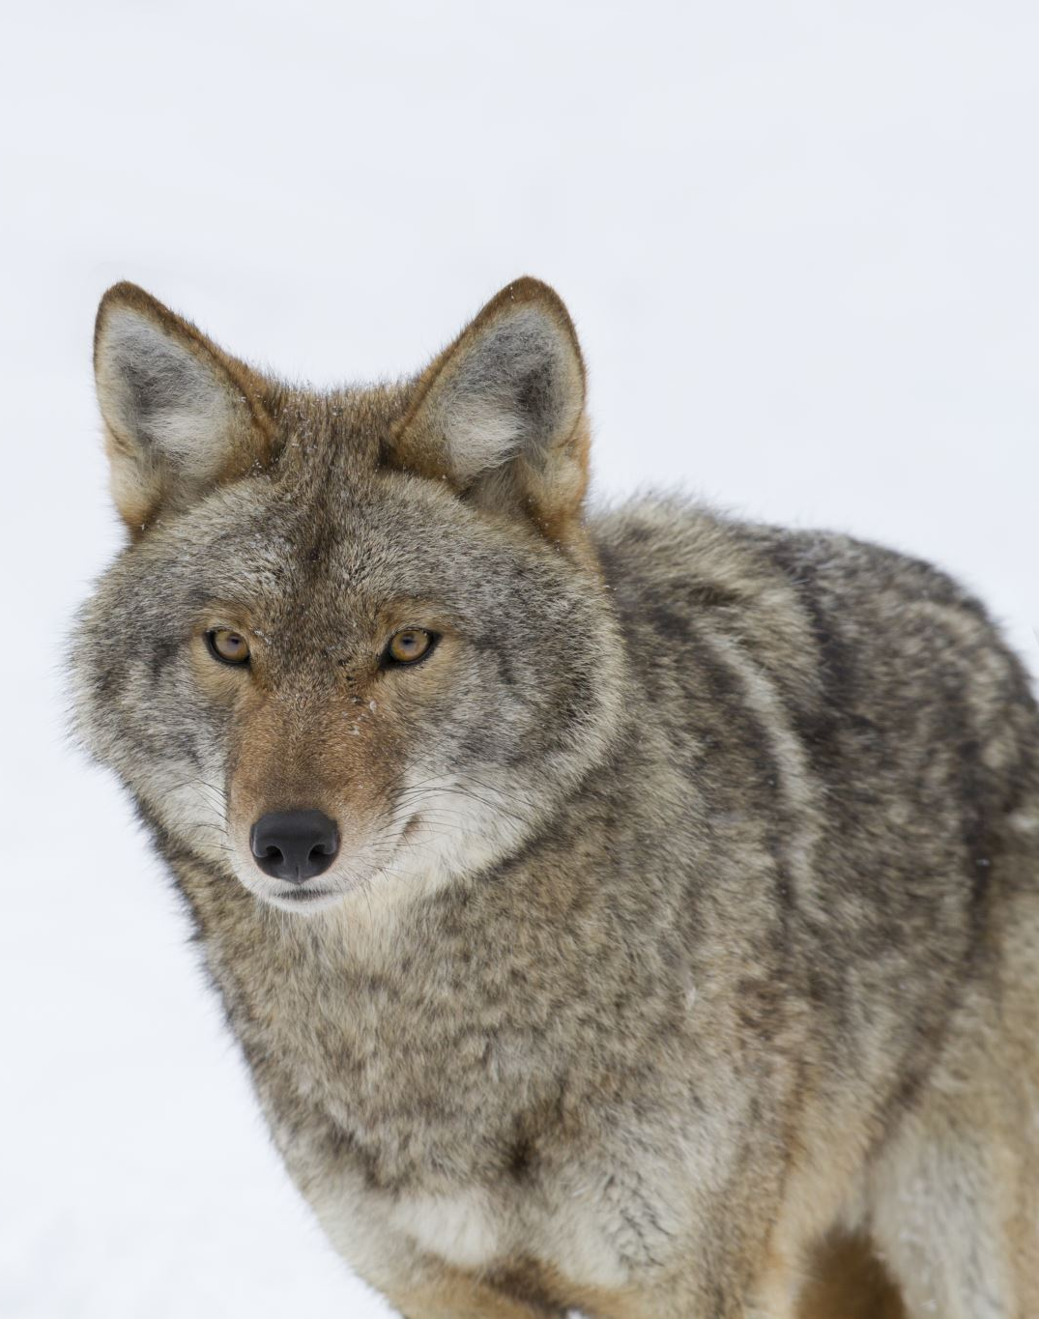
Relation of Category and Endangered Status
how representative are the grades among conservation status?
what are the proportions of categories to each other, which is the most representative category in this data?
how is the proportion of species in somehow endangered status to all species?
is there a connection between categories and being in somehow endangered?

Slide 8
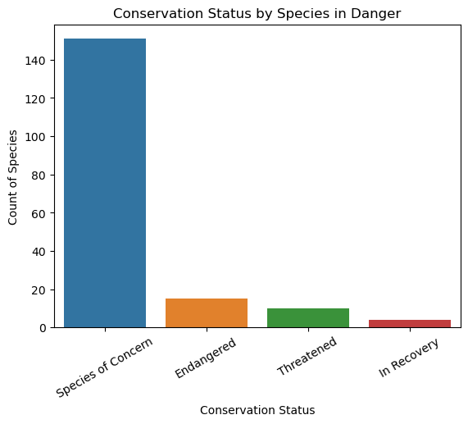
Conservation Status by Species in Danger
all: 180
concerned grade: 151 – 83%
Endangered: 15 – 8.3 %
Threatened: 10
In Recovery: 4

Slide 9
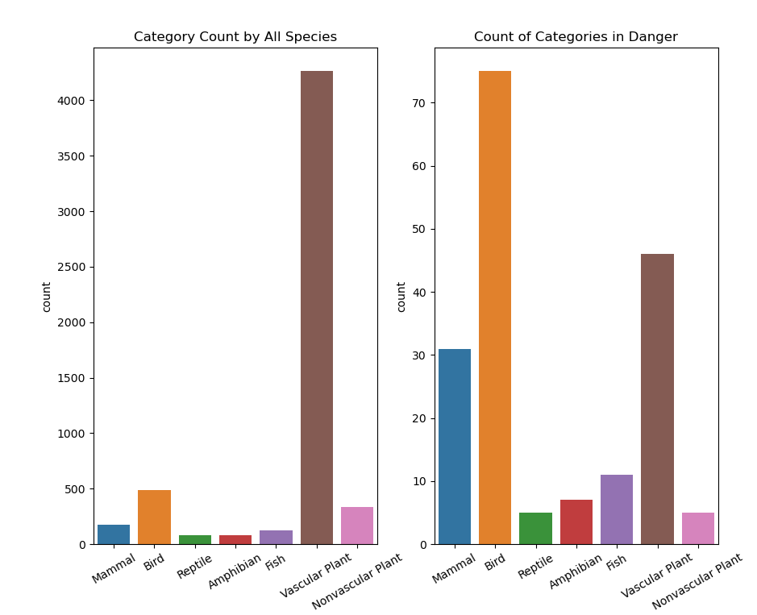
Representation of Categories
All Data:
Vascular plants (4262)
Birds (488)
Nonvascular Plants (333)
Mammal (177)
In Danger:
Birds (79)
Vascular Plants (46)
Mammal (38)
6. Nonvascular Plants (5)
.

Slide 10
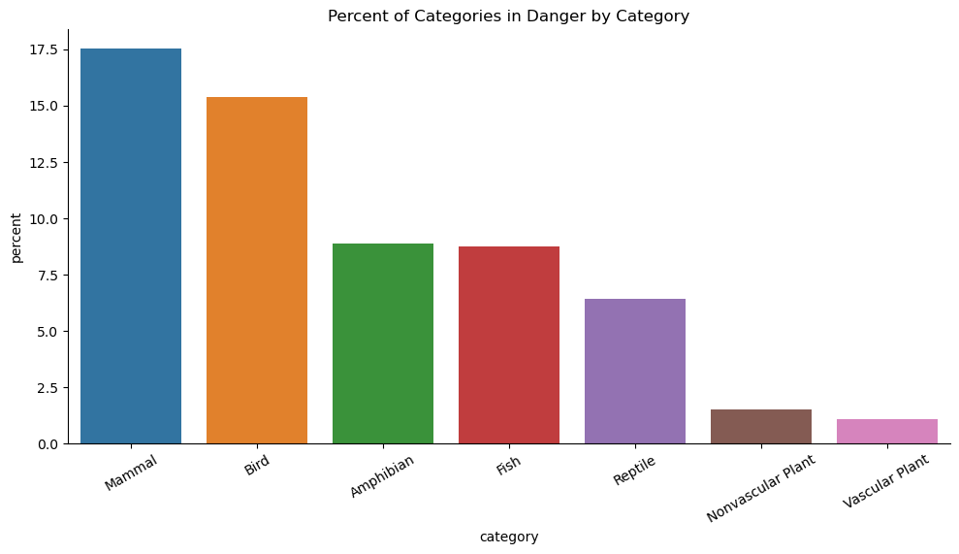
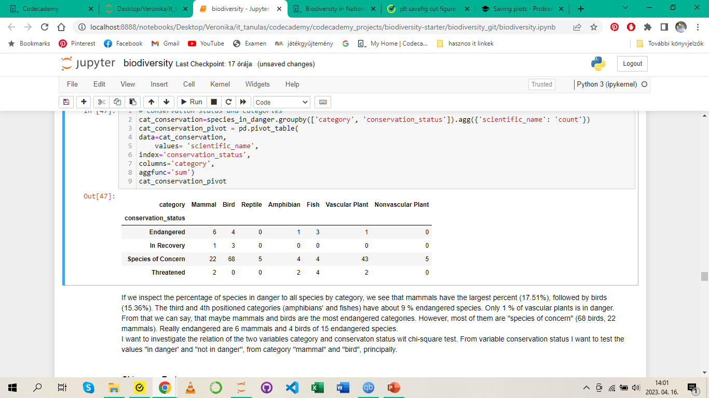
Proportion of Species in Danger to All Species

Slide 11
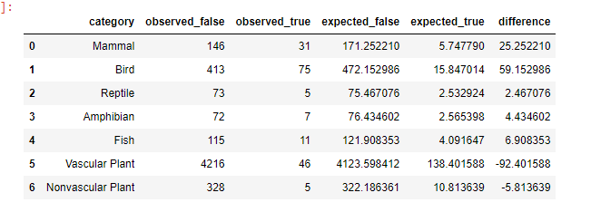
Relation of Category and Endangered Status
Method: chi-square tests
Focus: in danger – not in danger / mammals – birds
Significance treshold for p-value: 0.05
For chi2: 4

Slide 12
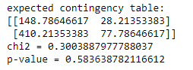
Mammal vs Bird
p-value = 0.58
much larger than the genereal significance treshold 0.05.
Chi2 = 0.3
smaller than 4
there does not seem to be a relation between birds and mammals being in danger

Slide 13
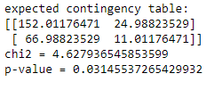
Mammal vs Reptile
p-value = 0.03
smaller than 0.05,
the chi-square value = 4.63
greater than 4
It seems to be a relation between mammal and reptile being in danger: mammal have significant greater probability of being in danger than reptile.

Slide 14
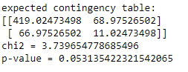
Bird vs Reptile
The p-value = 0.053
which is the significance treshold
The chi2-value =3.74
a little bit smaller than 4.
The relation between birds and reptile being in danger is maybe significant, but the relation is weak.

Slide 15

Relation of Endangered Status and National Park
Number of Observations of Species in Danger in National Parks
Observations of Species in (endangered/ in danger/not in danger) Status in Parks
Observations of Common Names in National Parks

Slide 16
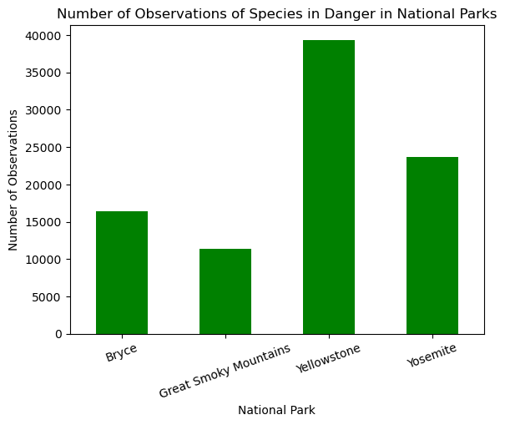
Number of Observations of Species in Danger in National Parks

Slide 17
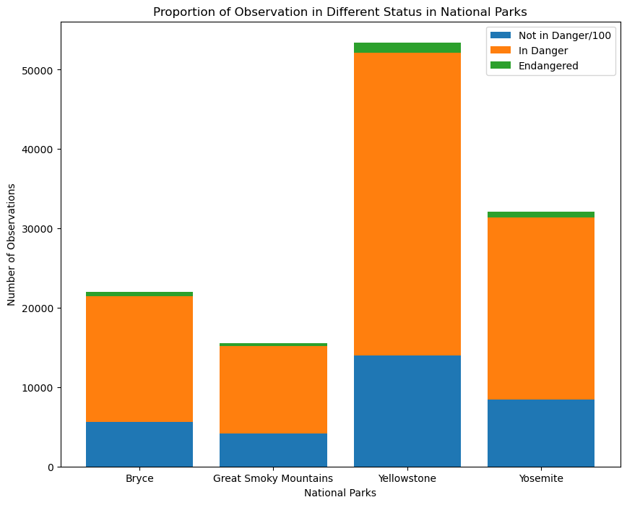
Observations of Species in Different Status in Parks
I devided the number of all observations by 100 to show better the top of the bars where you can see the number of observation of endangered species
The number of observations are the highest in Yellostone National Park
among all observations: 43.54%
among species in danger: 43.34%)
among endangered species 43.88%
The same situation can be observed in other national parks. (Dataframe by Appendix).

Slide 18
Observations of Common Names in National Parks
The observations of the Gray Wolf are in all National Parks high
The numbers are in Yellowstone National Park the highest, but proportionately they are the same for each record.
It can not be observed any relations between endangered status and national parks.

Slide 19

Discussion
Reason for high representation of gray wolves
Reason for high observation numbers in Yellowstone National Park
More data for research of relation being in danger and category

Slide 20
Appendix
Presentation of the Databases
Number of Observations of Species in Danger by Categories
Observations of Species in Different Status in Parks
Number of Endangered Species in National Parks

Slide 21

Species
5824 records in 4 columns
category: taxonomy of species.
'Mammal', 'Bird', 'Reptile', 'Amphibian', 'Fish', 'Vascular Plant', 'Nonvascular Plant’
scientific_name: Latin name of species
common_names: common used names of species
conservation_status:
4 values, a big percent of them is NaN.
other values: ‚Species of Concern', 'Endangered', 'Threatened', 'In Recovery’ = that the animal/plant is in kind of danger.
Maybe the data is missing structurally, and means that the conservation status is 'not endangered’: replaced Nan with ”not endangered”

Slide 22

Observations
23296 records in 3 columns:
scientific_name: Latin name of the plant/animal
park_name: locating of the observations
Great Smoky Mountains National Park, Yosemite National Park, Bryce National Park, Yellowstone National Park
obs_num: number of observations

Slide 23
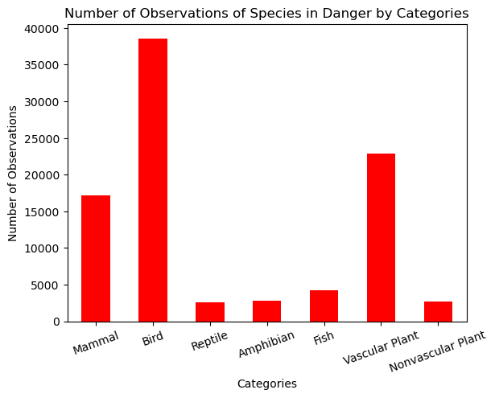
Number of Observations of Species in Danger by Categories

Slide 24
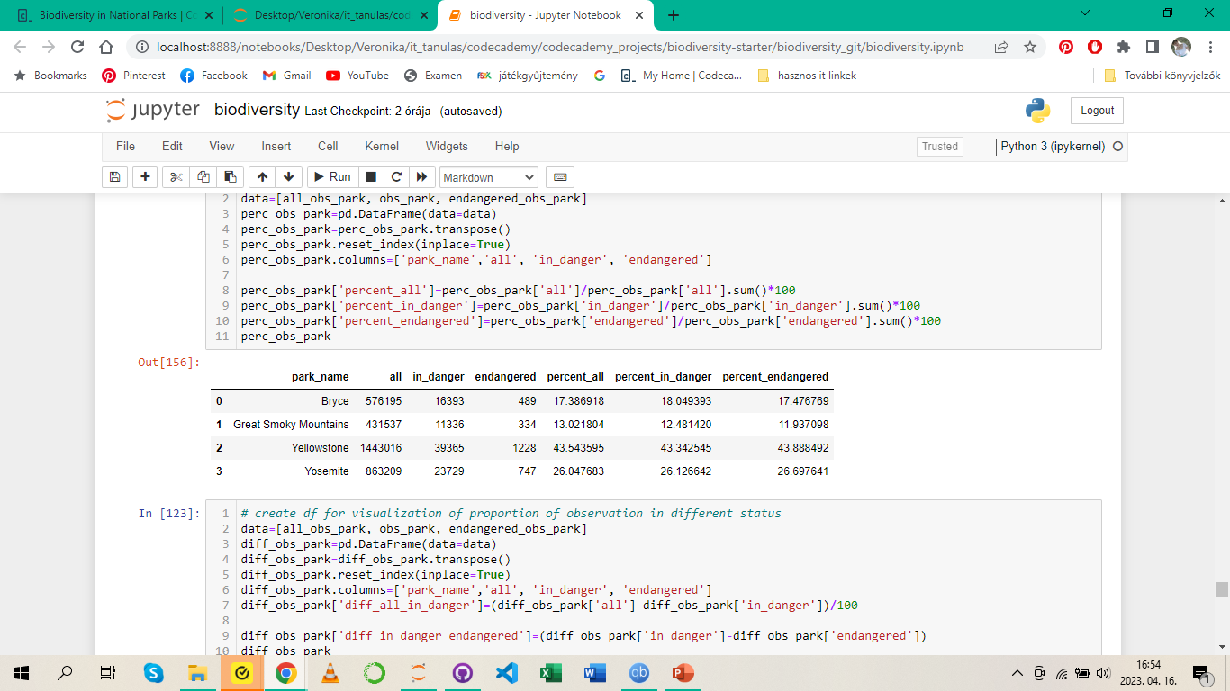
Observations of Species in Different Status in Parks

Slide 25
Endangered Species

Slide 26
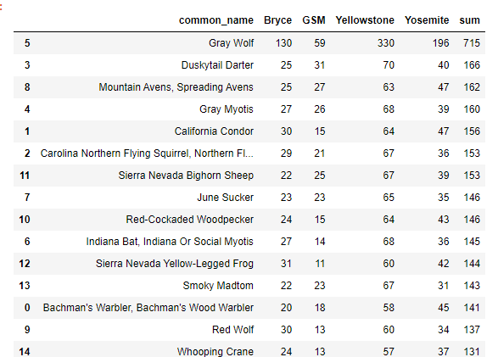
Endangered Species - Dataframe

